Slide 1

Prototyping and Systems Engineering Presentation
Team Members :
Pisula Guruge
Mehedi Hasan
Masrur Jamil prochchhod
Jiban-Ul Azam Chowdhury Shafin

Slide 2

Motivation

Slide 3
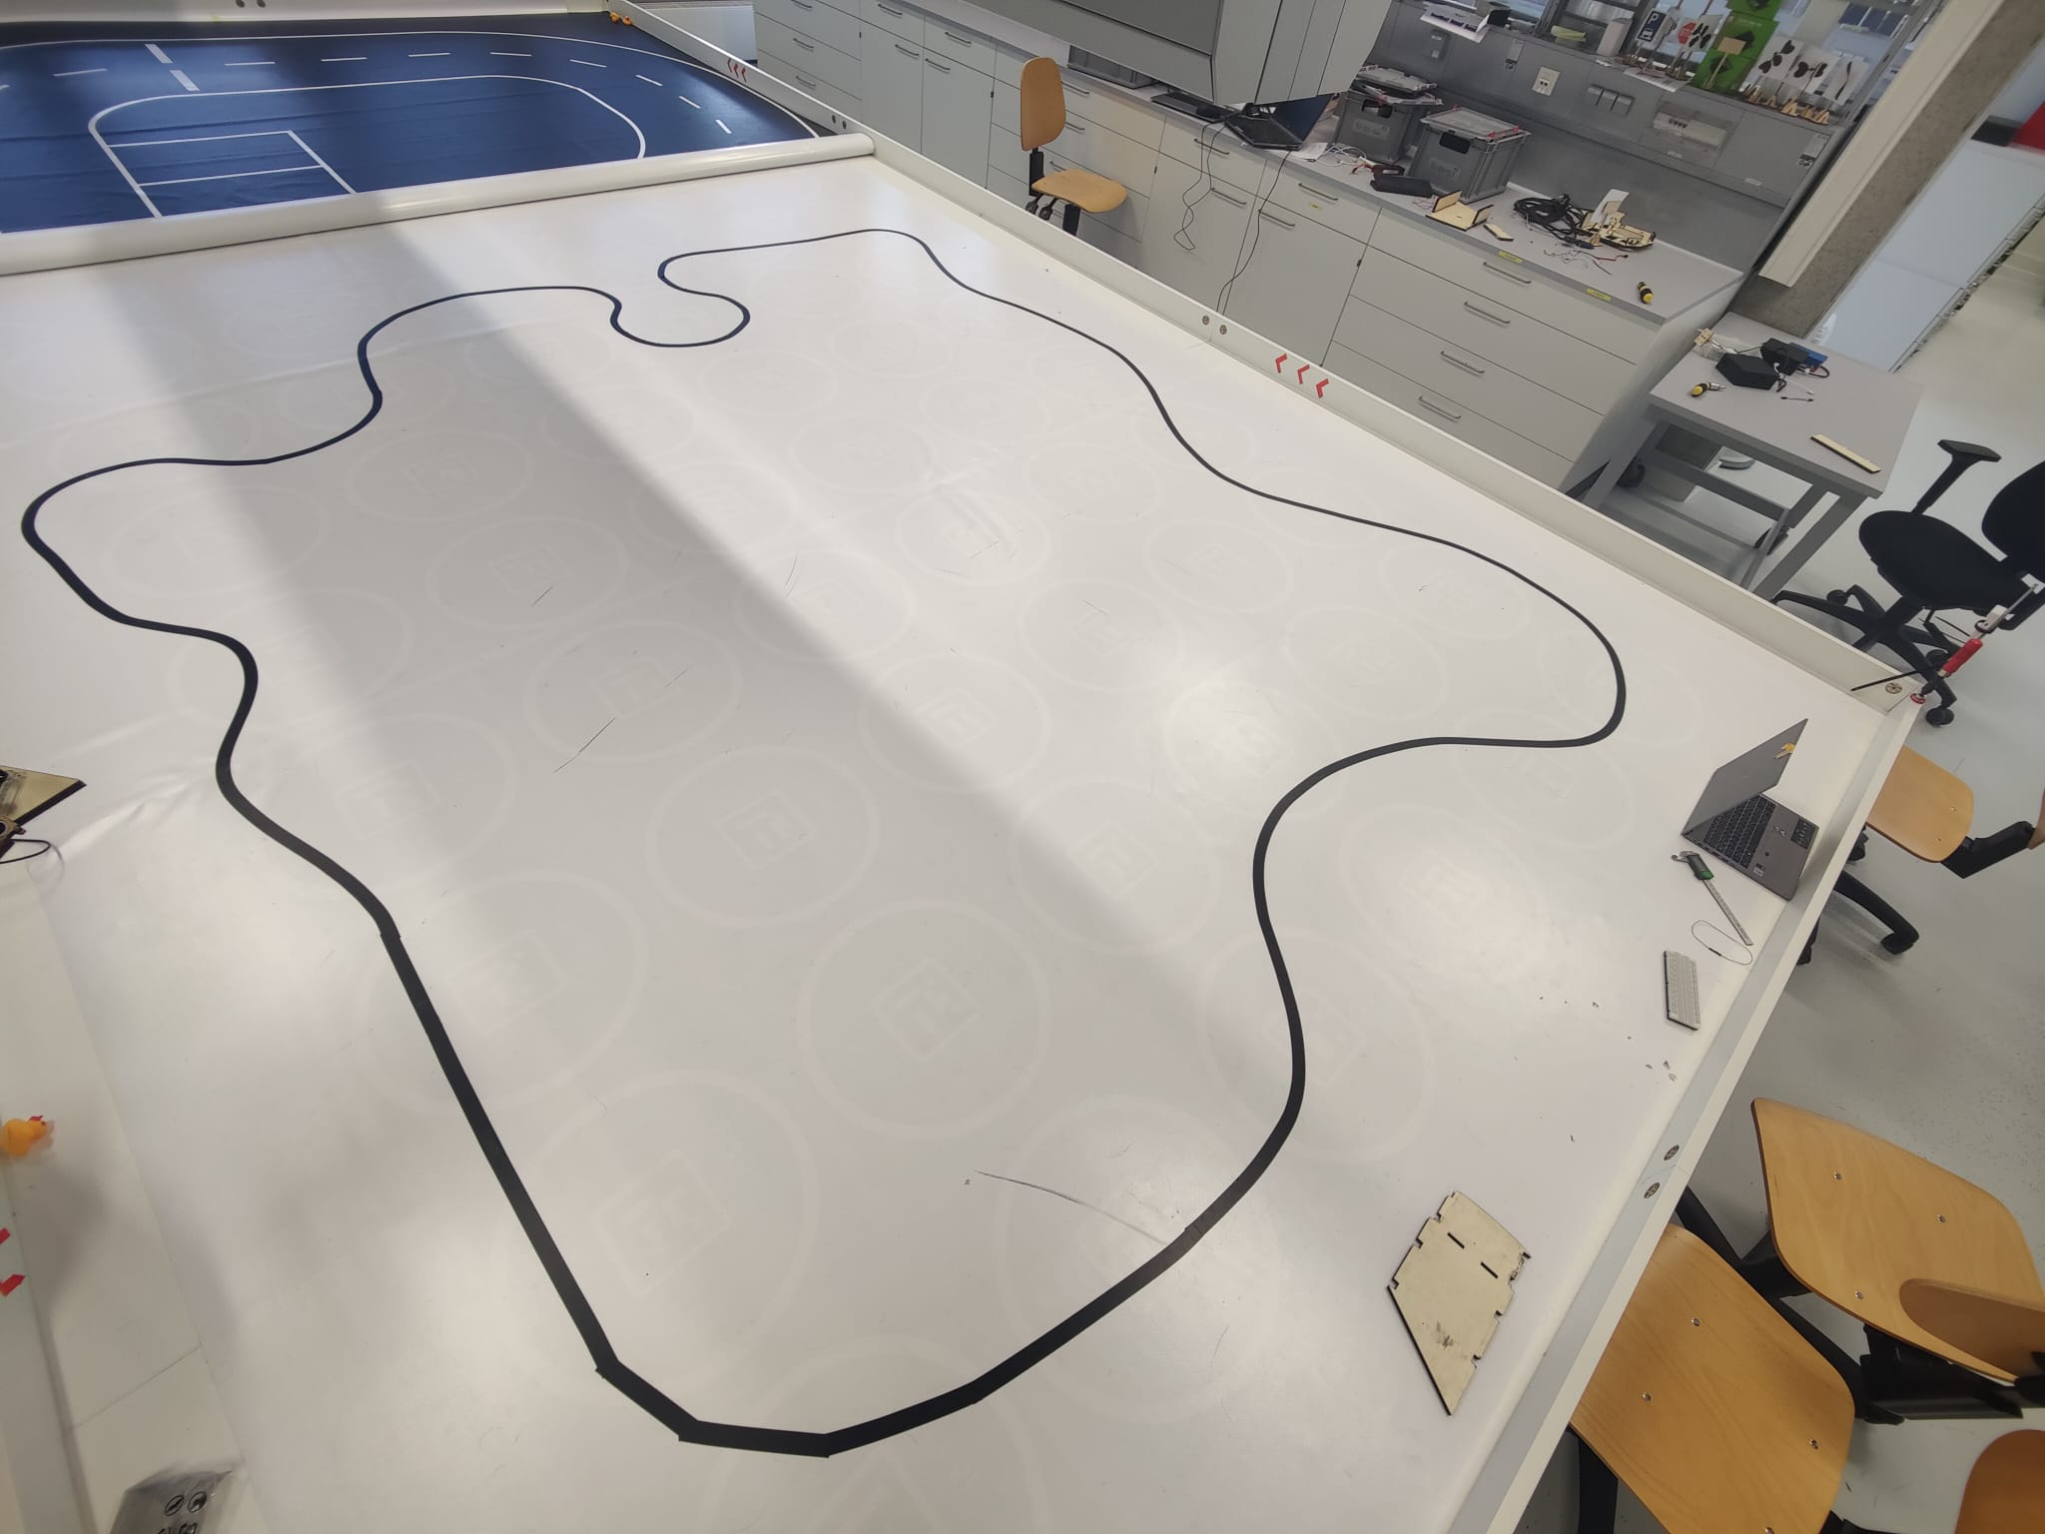
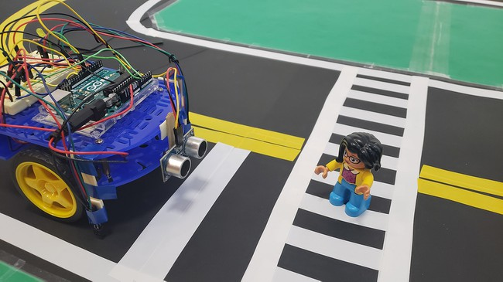
Overview
Develop an autonomous vehicle that can drive autonomously on a given track.
[1]

Slide 4
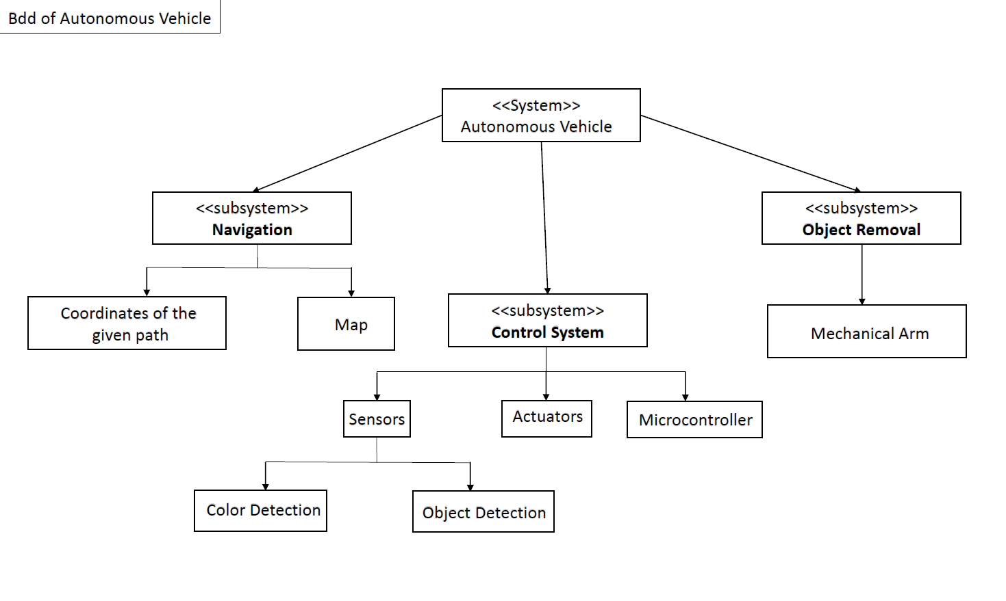
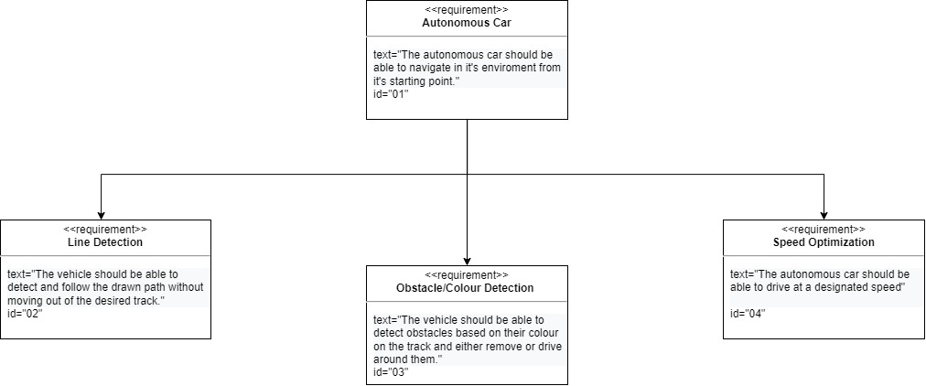
SysML Diagrams and Uppaal Model
BLOCK DIAGRAM
REQUIRMENT Diagram

Slide 5
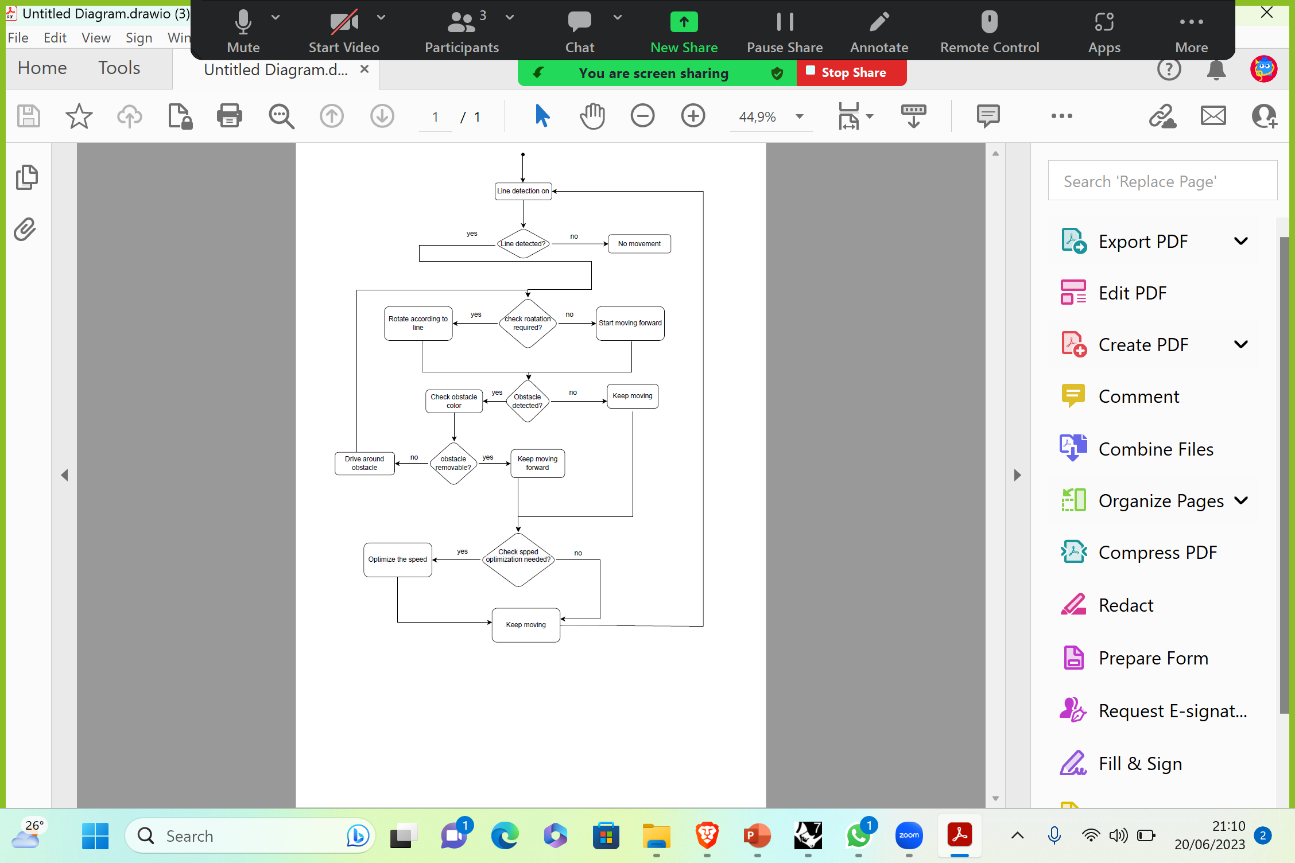
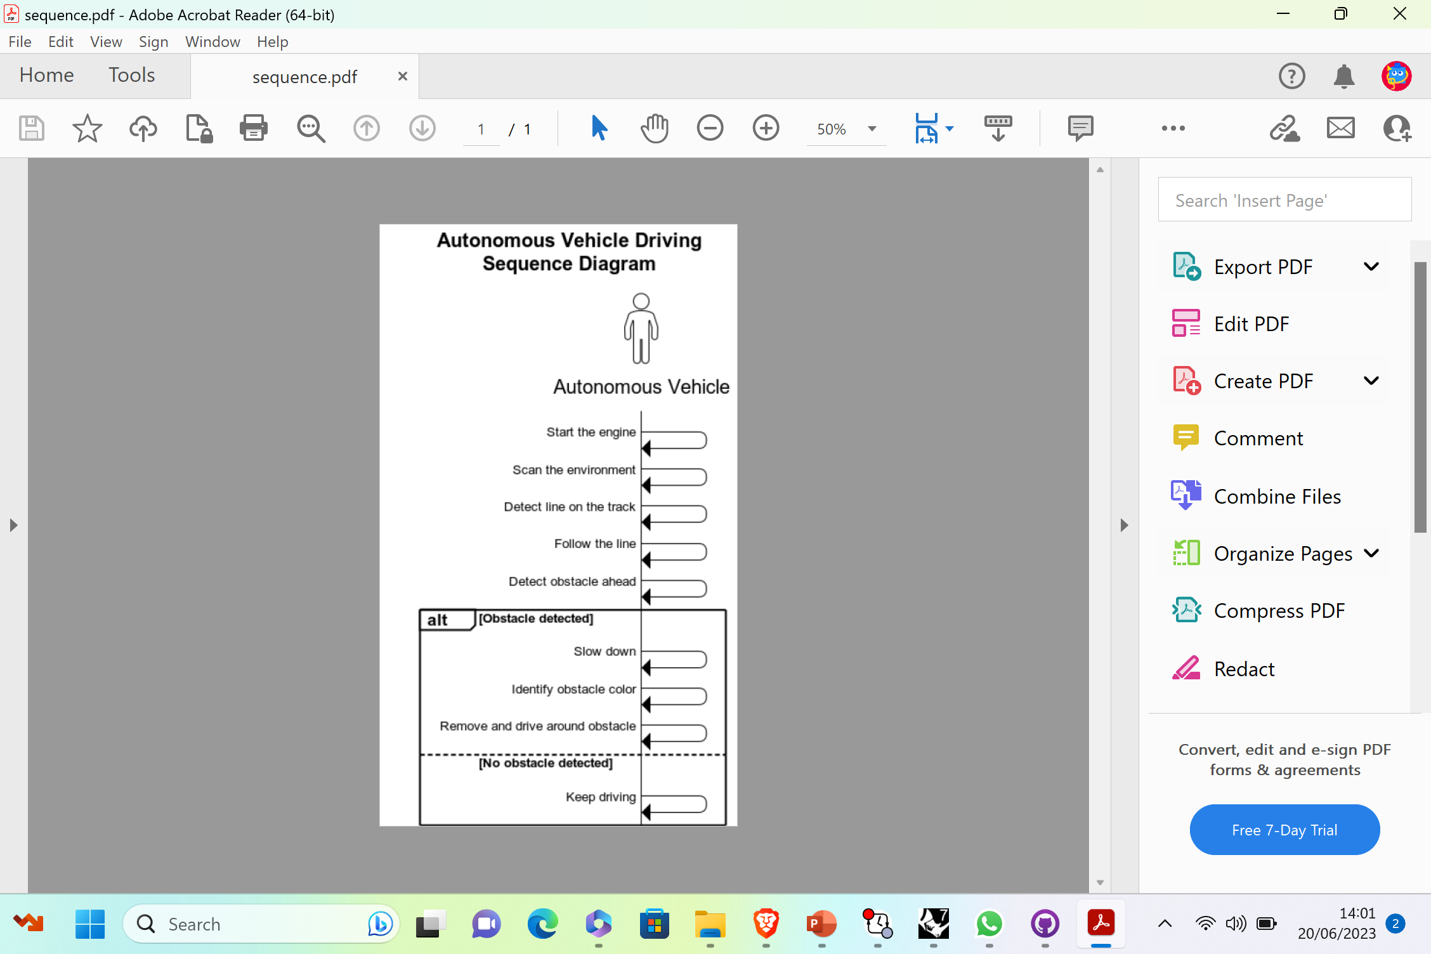
ACTIVITY DIAGRAM
SysML Diagrams and Uppaal Model
Sequence Diagram

Slide 6
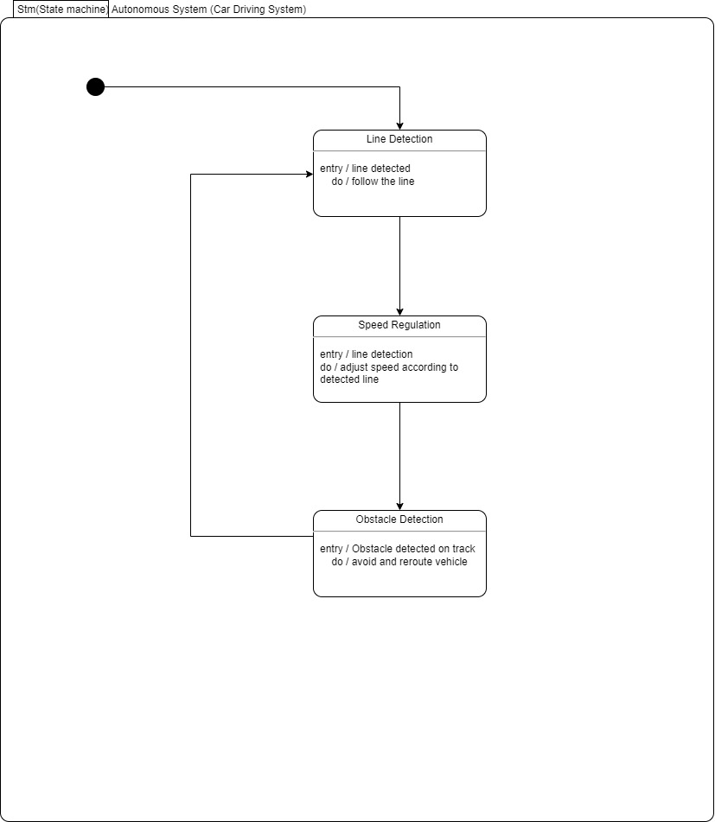
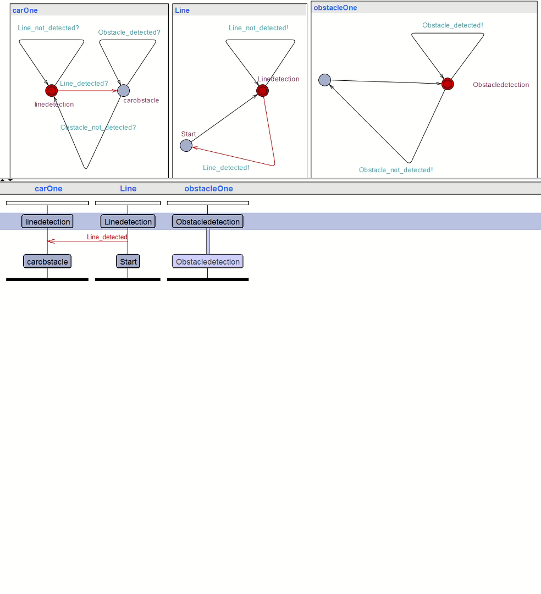
STATE MACHINE DIAGRAM
SysML Diagrams and Uppaal Model
Uppaal Model

Slide 7
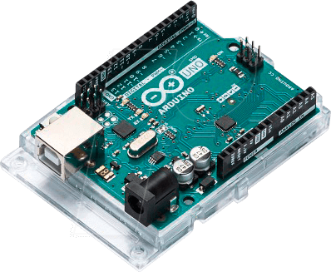
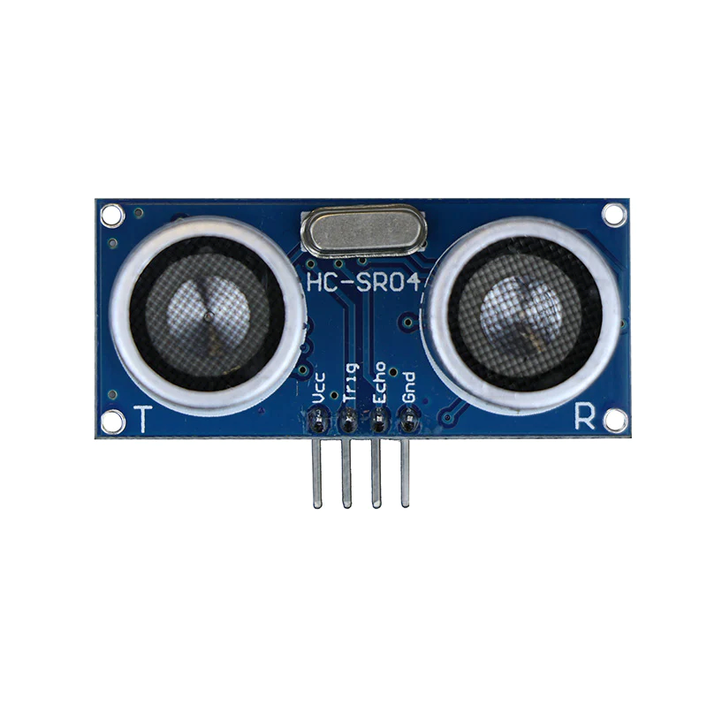
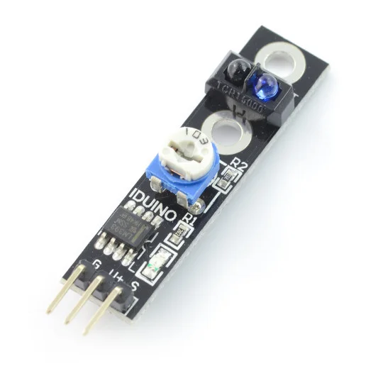
Hardware Components
Microcontroller - Arduino Uno
Line sensor (IR Sensor,ST1140)
Ultrasonic Sensor (HC-SR04)

Slide 8
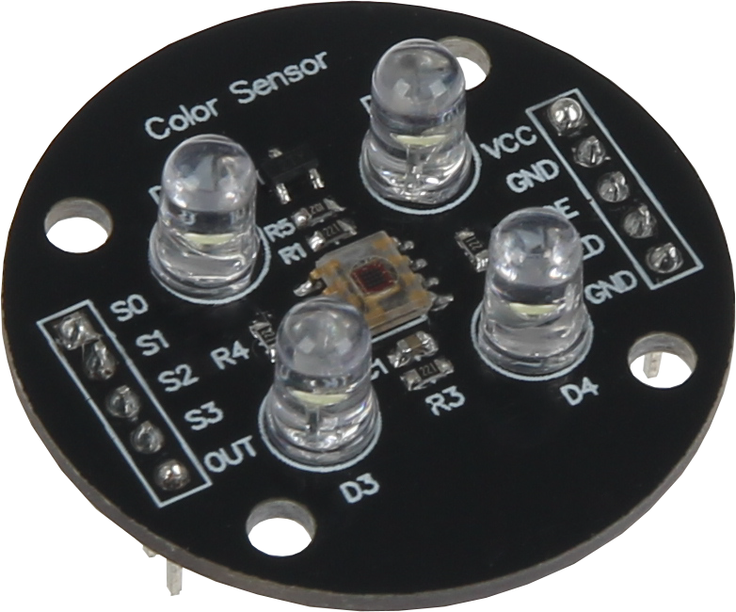
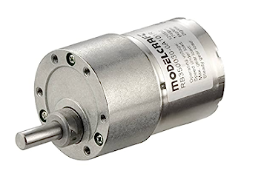
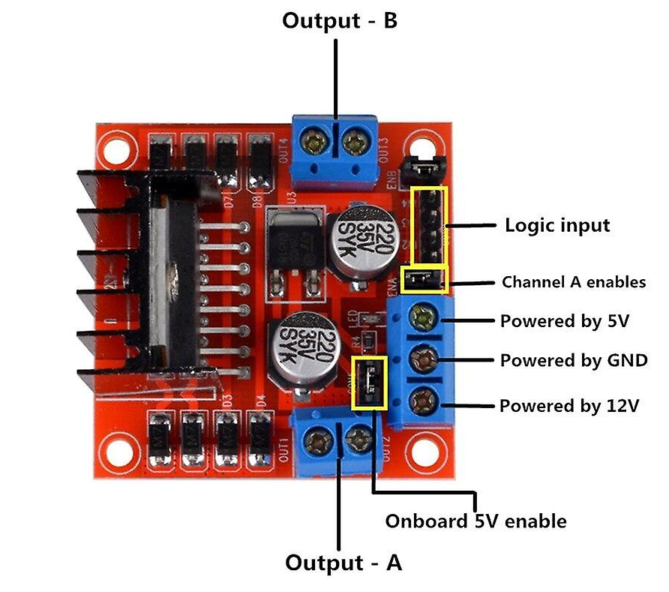
Hardware Componenets
Colour Sensor (TCS3200)
Motor Driver
2 DC Motors

Slide 9

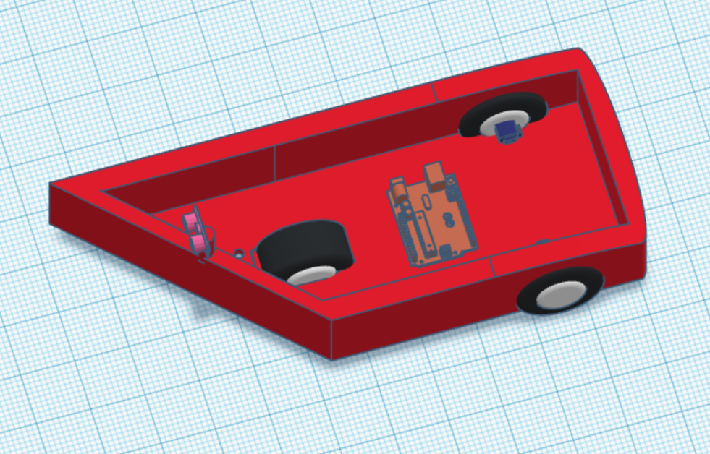
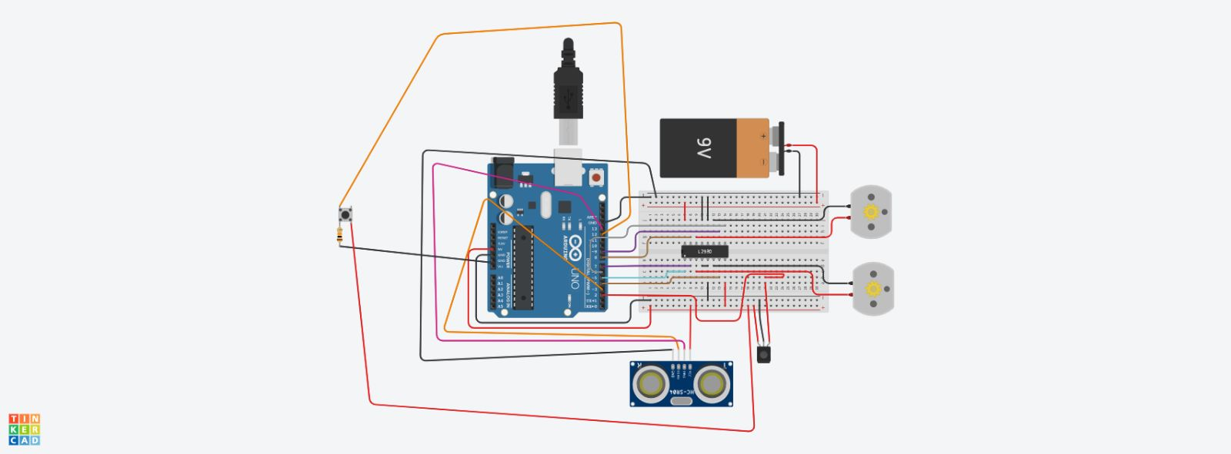
Design & Schematics

Slide 10

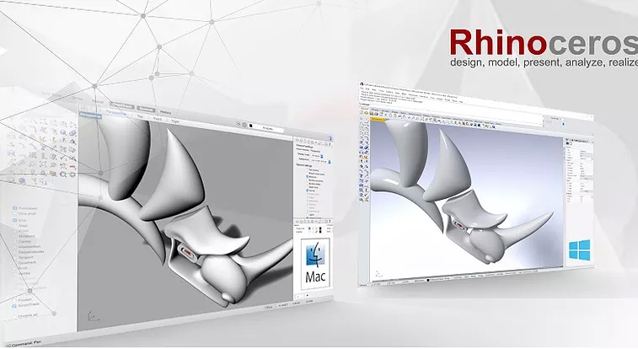
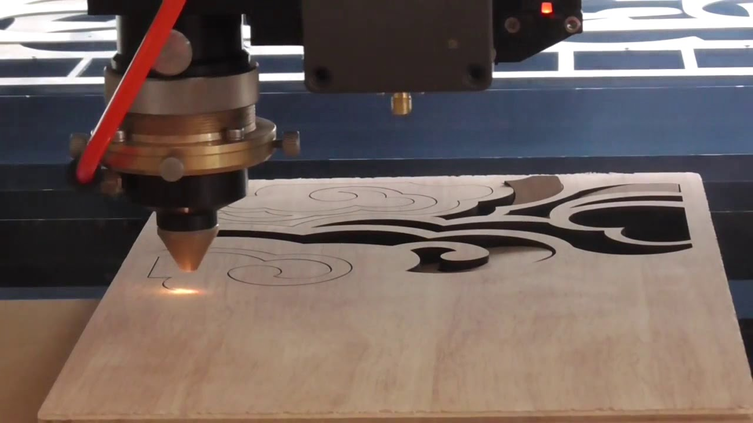
Design & Schematics
Technologies used
TINKERCAD
Rhinoceros
Laser Cutting of Plywood
[2]
[3]
[4]

Slide 11
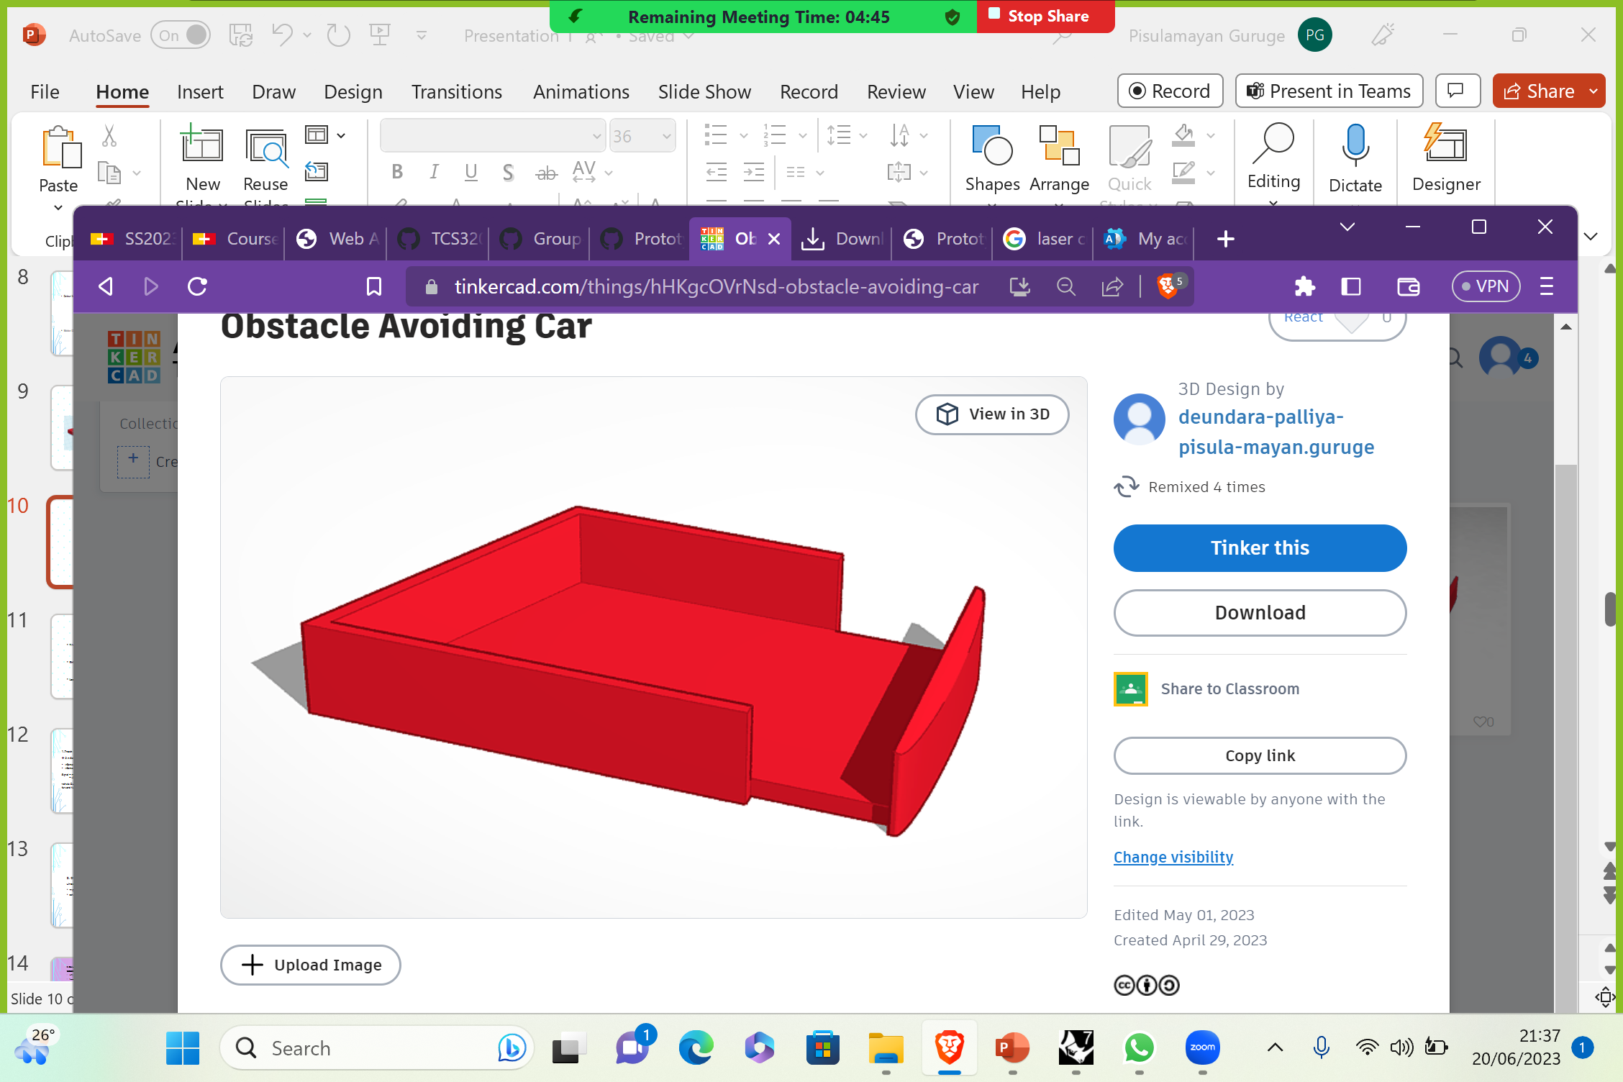
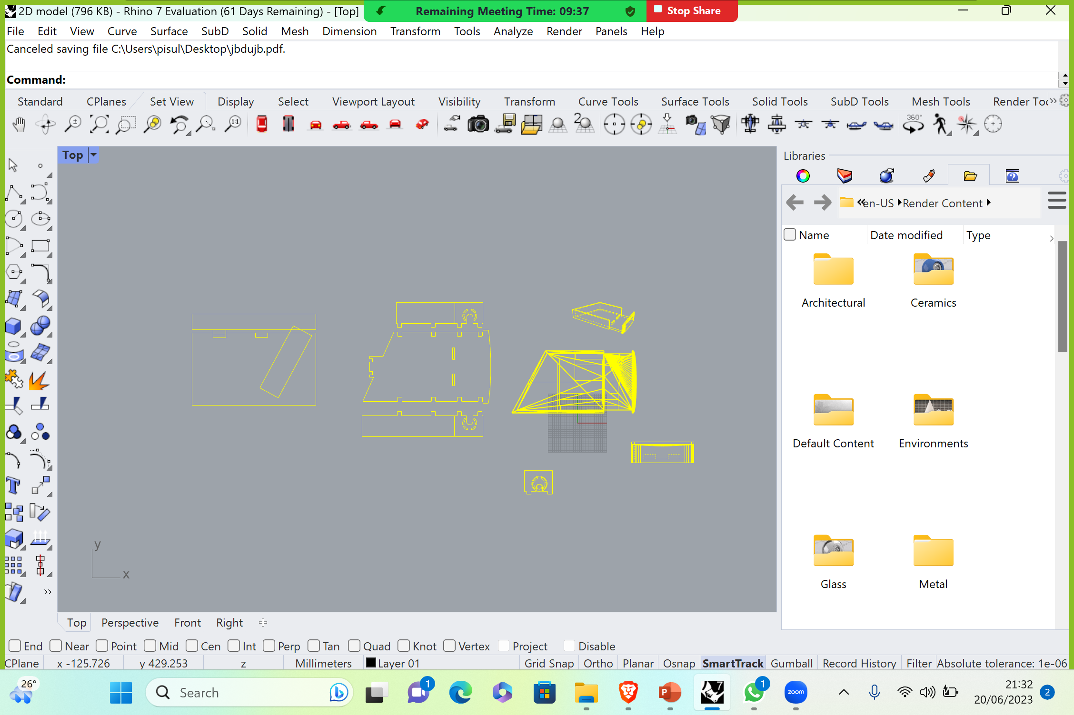
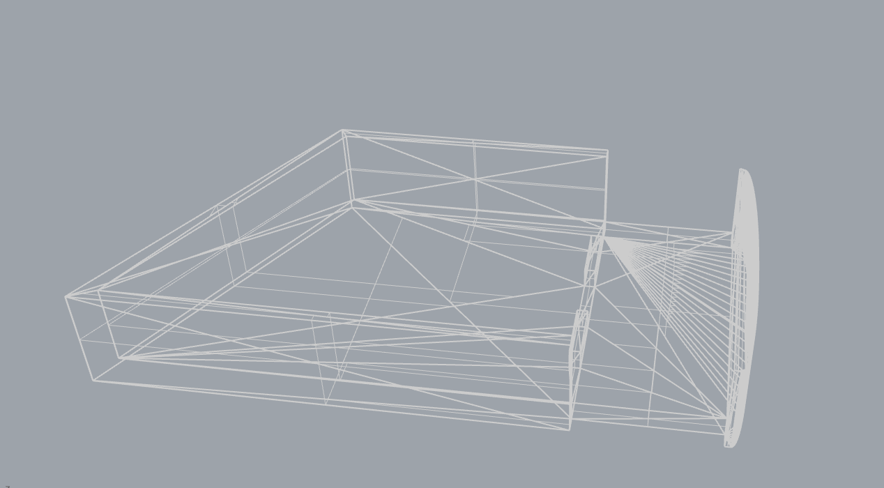
Tinkercad & Rhinoceros

Slide 12
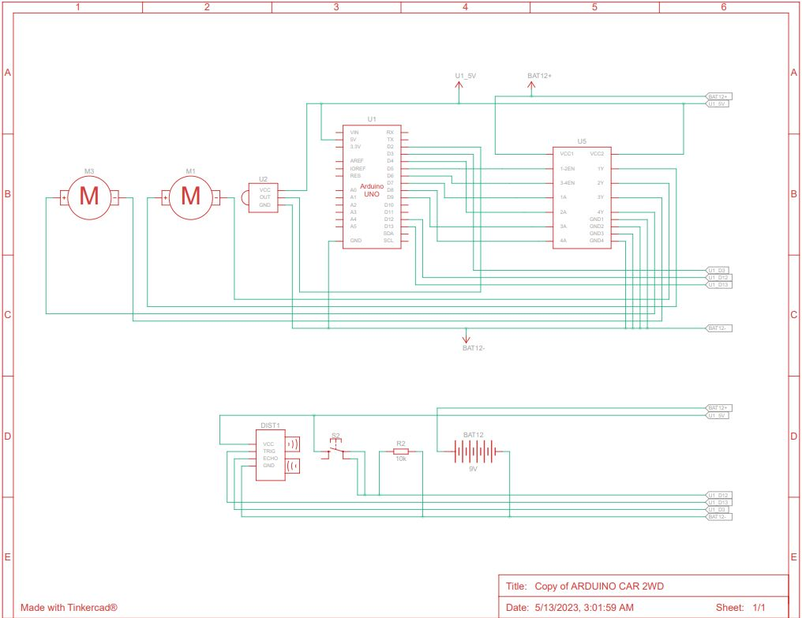
Design & Schematics

Slide 13
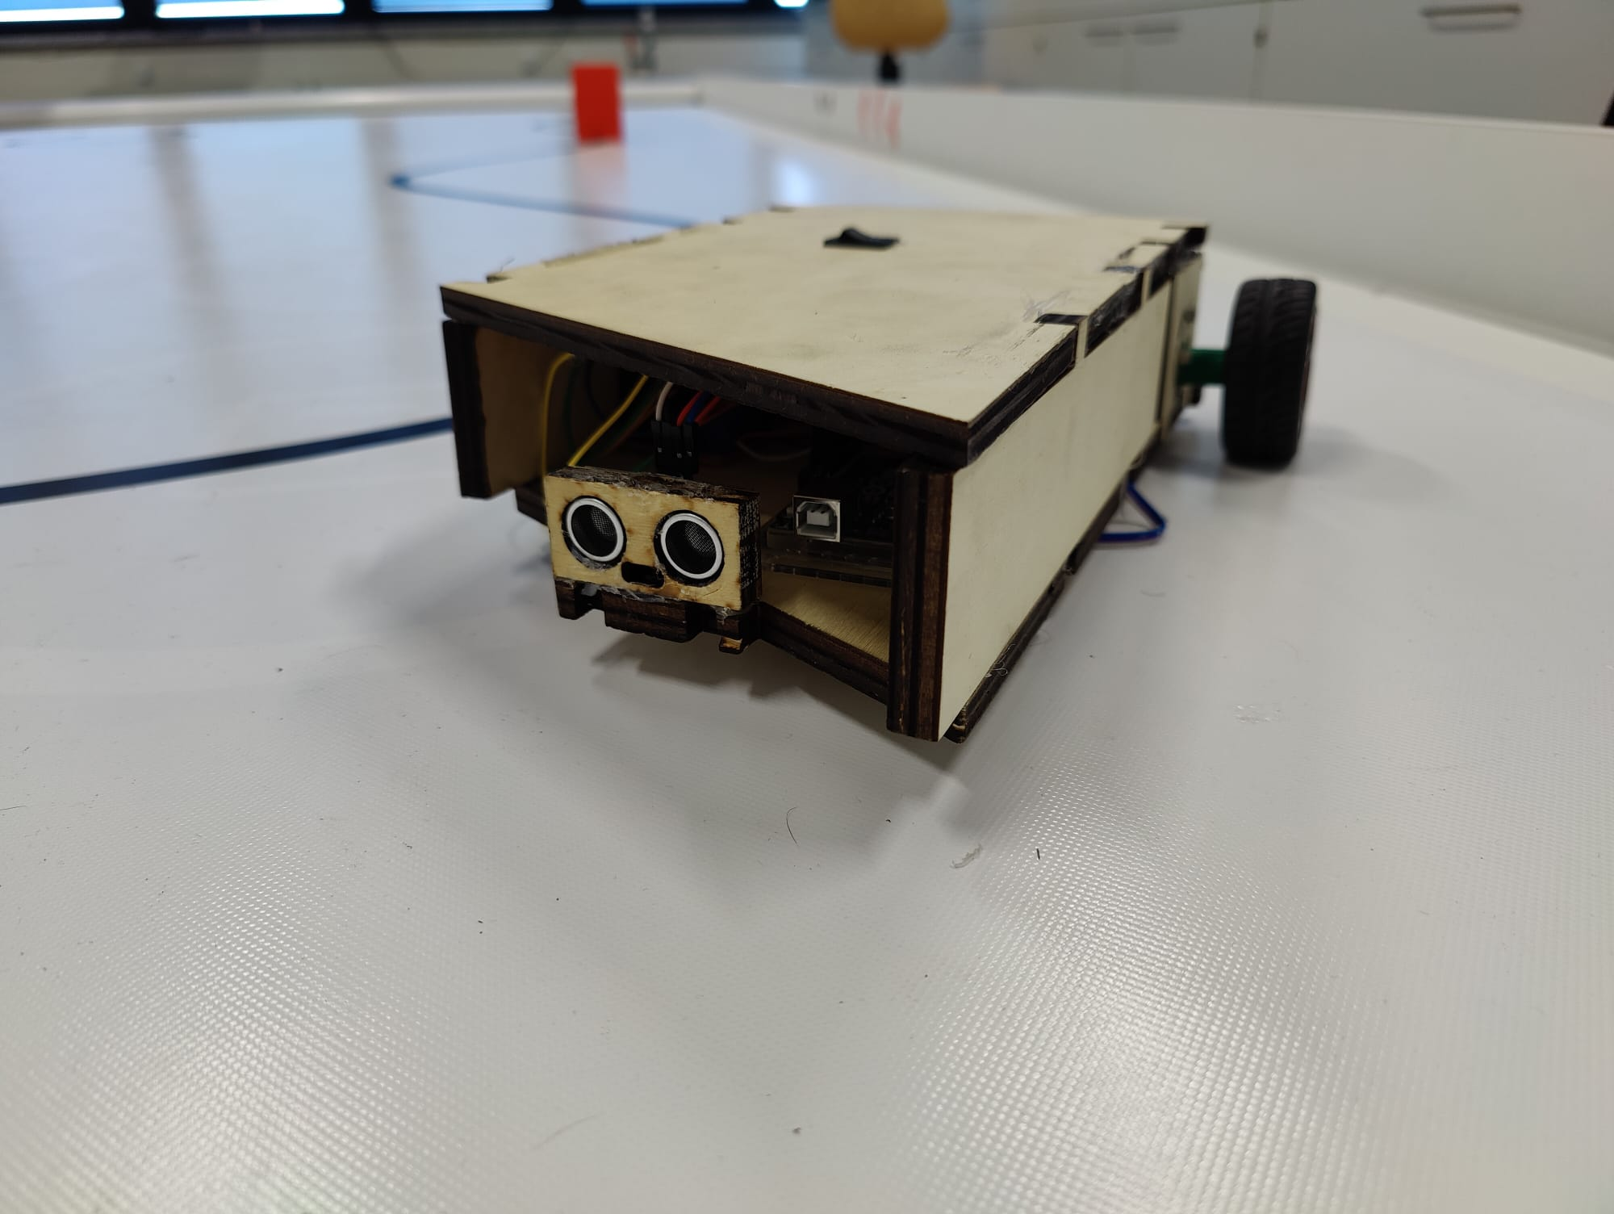
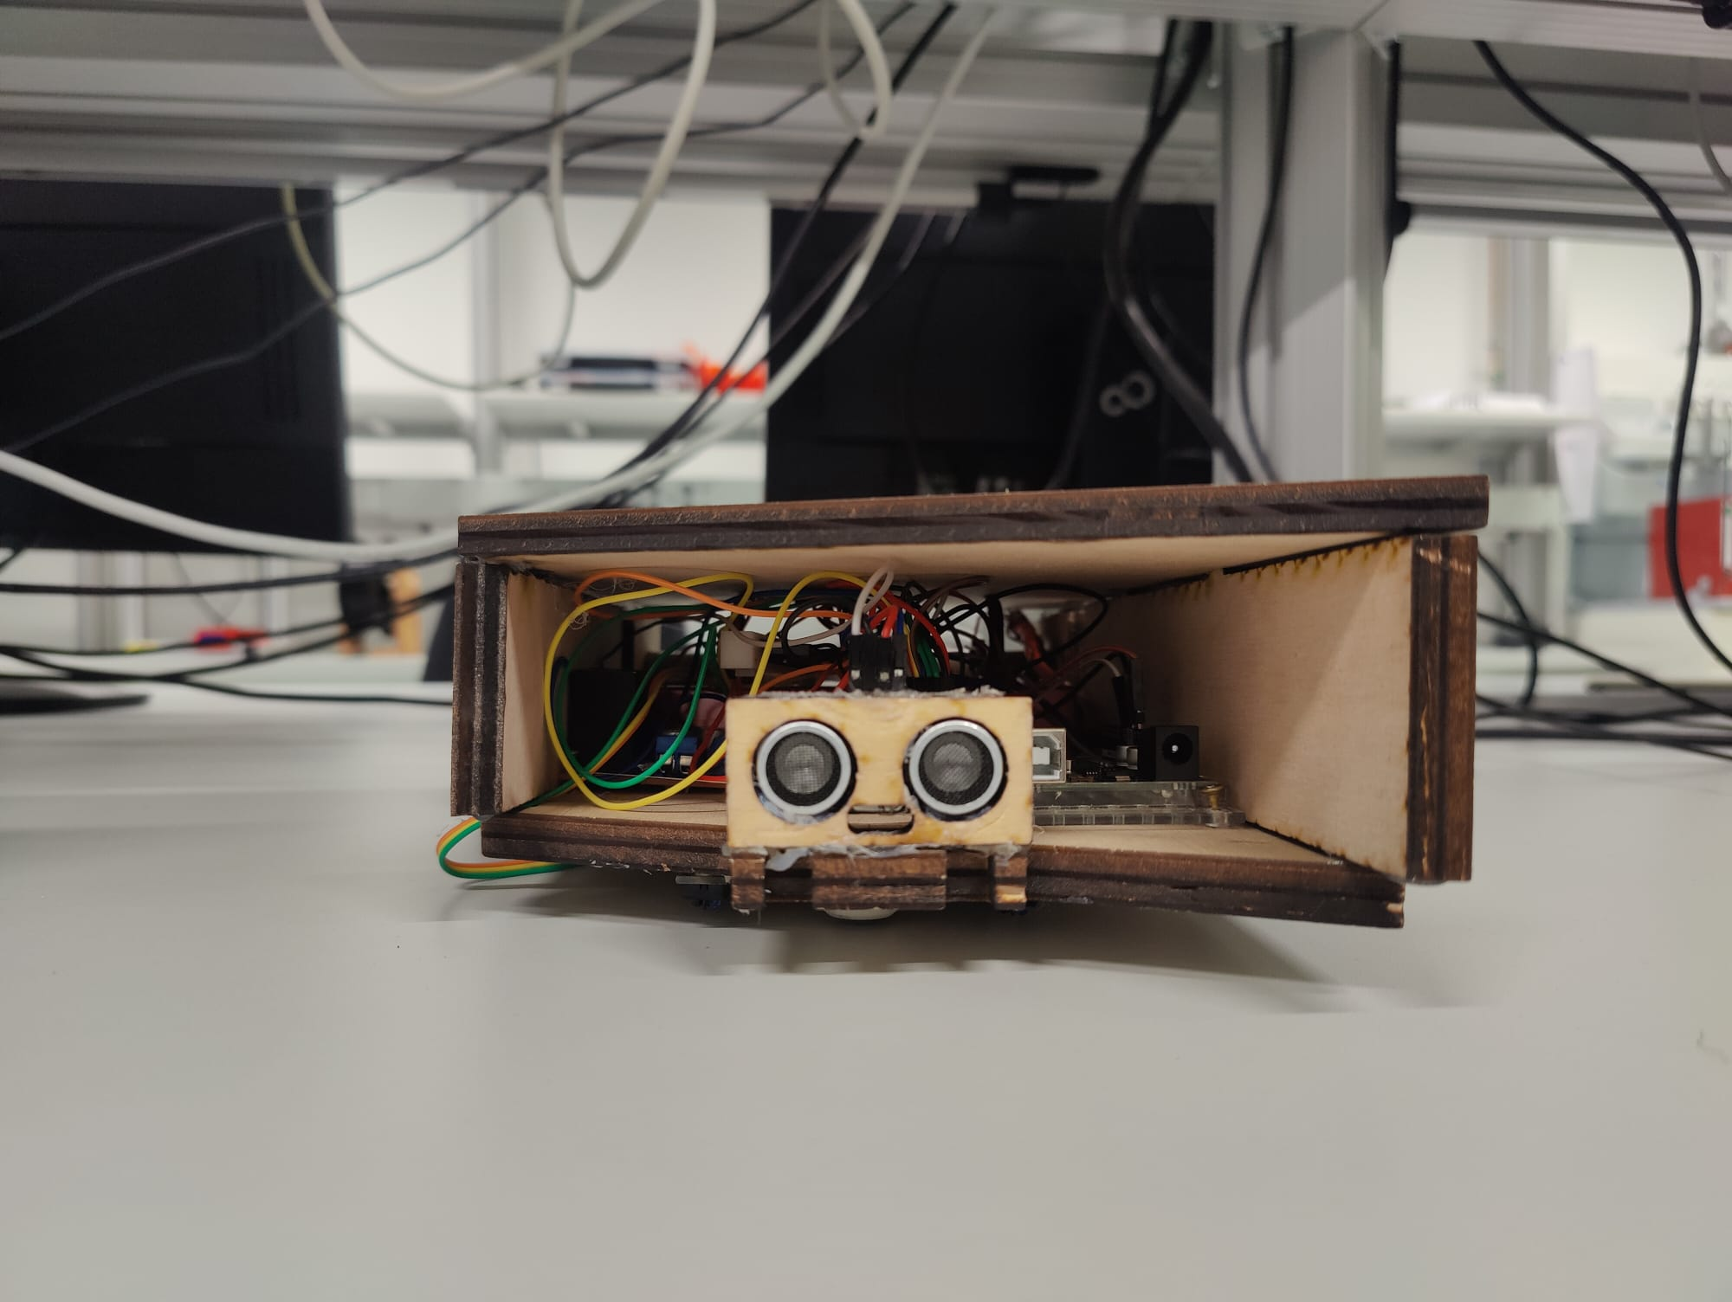
Final prototype

Slide 14
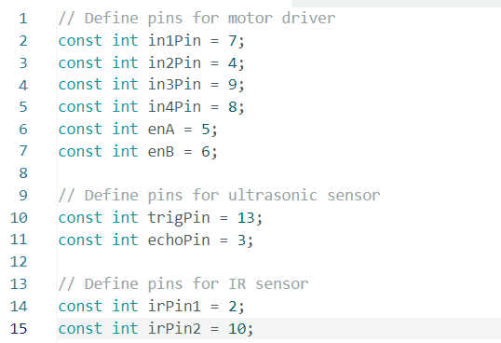
Code
1.Initialisation

Slide 15
Code
void forward() { // Moving Forward
digitalWrite(in1Pin, LOW);
digitalWrite(in2Pin, HIGH);
digitalWrite(in3Pin, LOW);
digitalWrite(in4Pin, HIGH);
} void right() { // Moving right side of the track
analogWrite(enA, 130);
analogWrite(enB,160 );
digitalWrite(in1Pin, LOW);
digitalWrite(in2Pin, HIGH);
digitalWrite(in3Pin, HIGH);
digitalWrite(in4Pin, LOW);
}
} // Initialize IR sensor pin
pinMode(irPin1, INPUT);
pinMode(irPin2, INPUT);
void loop() {
// Read IR sensor input
int irSensorValue1 = digitalRead(irPin1);
int irSensorValue2 = digitalRead(irPin2);
analogWrite(enA, 200);
analogWrite(enB,200 );
if (irSensorValue1 == 0 && irSensorValue2 == 0) {
forward();
} else if (irSensorValue1 == 1 && irSensorValue2 == 0) {
left();
} else if (irSensorValue1 == 0 && irSensorValue2 == 1) {
right();
}
}
1.Track Following
2 IR Sensor
IrSensor1( left ir Sensor)
IrSensor2( right ir Sensor)
Signal – HIGH When on White Path
– LOW When on Black Path
Vehicle Out of the track:- keeps moving forward using forward function until it finds the line again.

Slide 16
Code
// Ultrasonic sensor code
digitalWrite(trigPin, LOW);
delayMicroseconds(2);
digitalWrite(trigPin, HIGH);
delayMicroseconds(7);
digitalWrite(trigPin, LOW);
duration = pulseIn(echoPin, HIGH);
distance = duration/34.2;
if(distance==0){
distance=100;
}
2. Obstacle detection
Ultrasonic sensor detects obstacles by sending sound waves.
Trigger Pin – Sends high frequency signal
Echo Pin - Receive the Signal

Slide 17
if(distance<10)
{
left();
delay(1000);
forward();
delay(1700);
right();
delay(1400);
forwardU();
irSensorValue1 = digitalRead(irPin1);
irSensorValue2 = digitalRead(irPin2);
while(irSensorValue1 == 0 && irSensorValue2 == 0 ){
irSensorValue1 = digitalRead(irPin1);
irSensorValue2 = digitalRead(irPin2);
}
stop();
delay(2000);
forwardU();
delay(100);
irSensorValue2 = digitalRead(irPin2);
turn();
while(irSensorValue2 == 0){
irSensorValue2 = digitalRead(irPin2);
}
}
}
2. Obstacle avoiding
movement sequence:
left() - turning left to avoid the obstacle
forward() - moving forward to pass the obstacle
right() - turning right to align with the original track
forwardU() - continuing forward after avoiding the obstacle

Slide 18
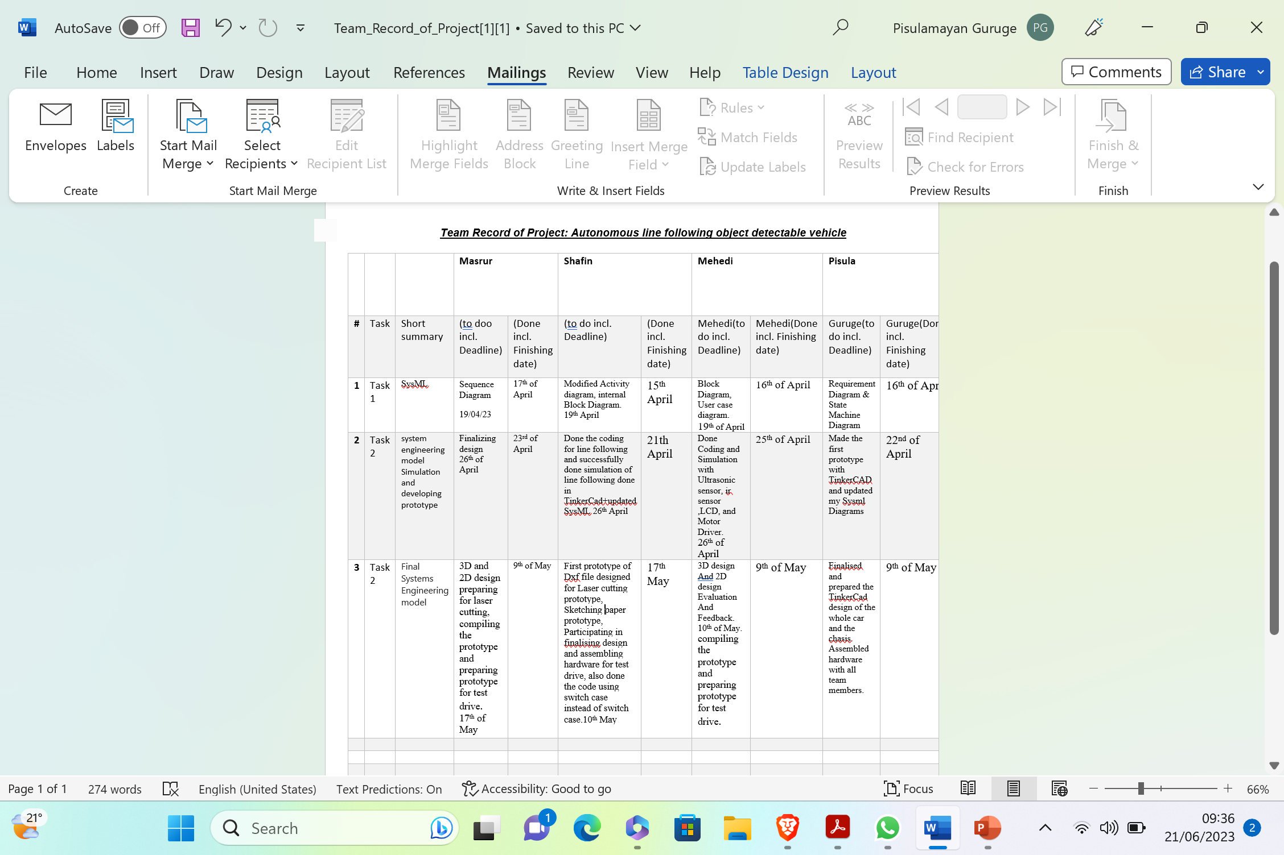
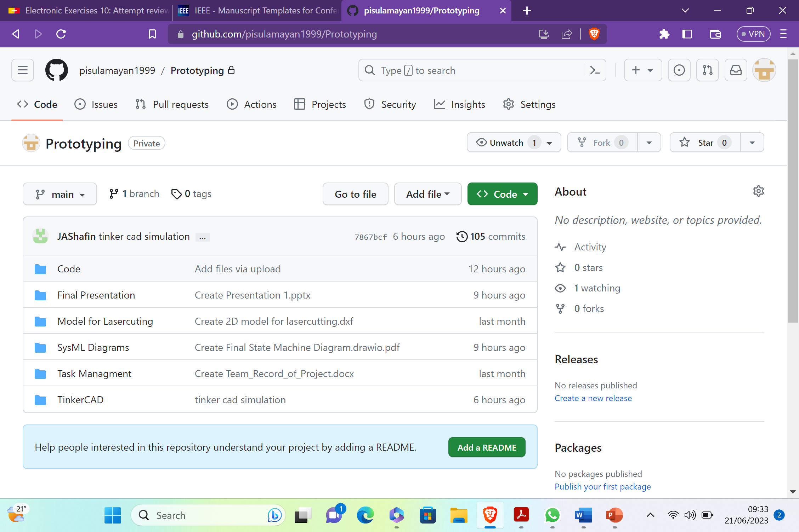
GItHUb and task distrubution

Slide 19
References
[1]https://www.google.com/url?sa=i&url=https%3A%2F%2Fwww.sciencebuddies.org%2Fscience-fair-projects%2Fproject-ideas%2FRobotics_p042%2Frobotics%2Farduino-self-driving-car&psig=AOvVaw12ht2KLSrzdI5yJLgyfdQz&ust=1687195535503000&source=images&cd=vfe&ved=0CBEQjRxqFwoTCLCs_6arzf8CFQAAAAAdAAAAABAR
[2] https://upload.wikimedia.org/wikipedia/commons/thumb/4/4c/Logo-tinkercad-wordmark.svg/2560px-Logo-tinkercad-wordmark.svg.png
[3] https://www.einscan.com/wp-content/uploads/2018/11/pressrel1.jpg
[4] https://i.ytimg.com/vi/PrhFy8tD2t4/maxresdefault.jpg

Slide 20
Results and conclusion
Develop an autonomous vehicle that can drive autonomously on a given track.
Being able to detect obstacles, avoid the obstacle and return back to the track.
Optimize and maintain a constant speed.

